Slide 1
Describing IP Networks
Section 8 from DEVASC
Manoj Papisetty (mpapiset)

Slide 2
Let’s start with a quiz!

Slide 3
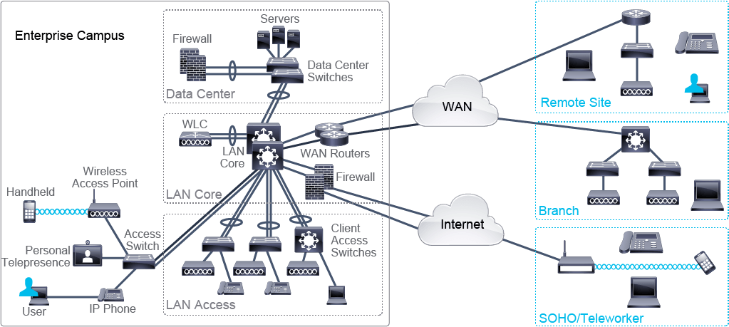

Slide 4
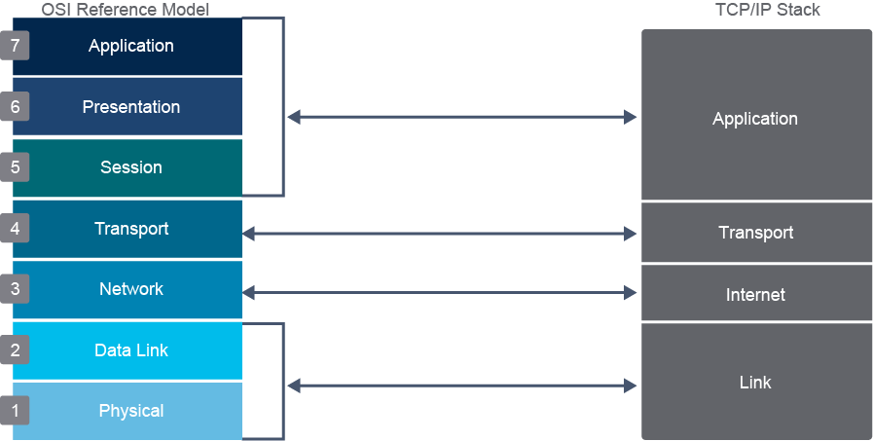

Slide 5
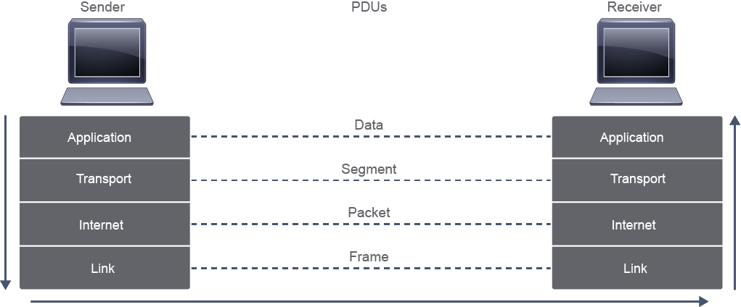

Slide 6
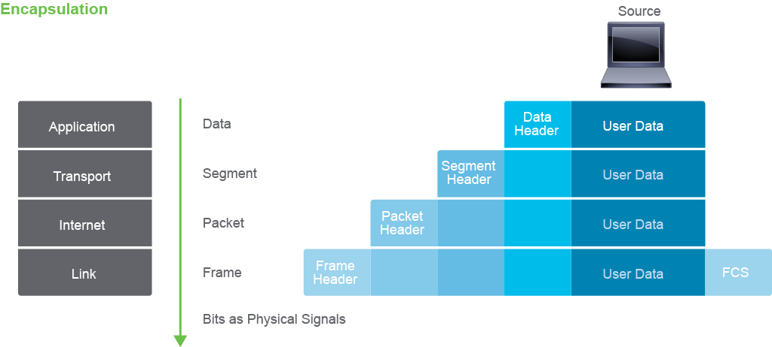

Slide 7
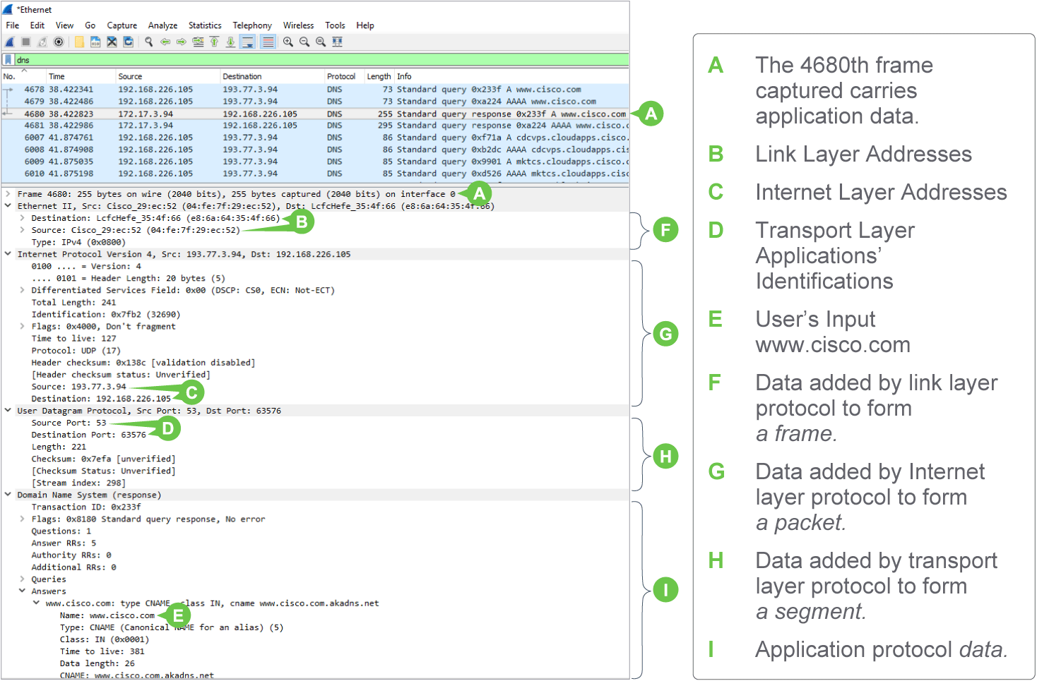

Slide 8
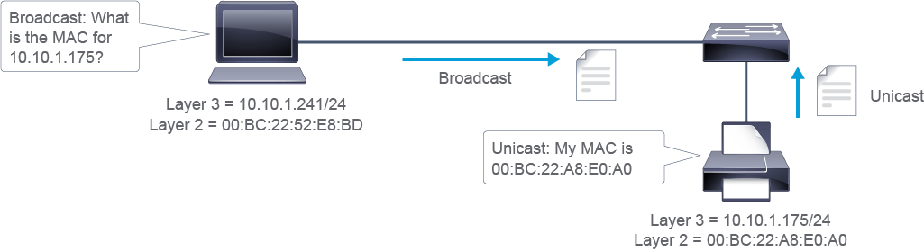

Slide 9
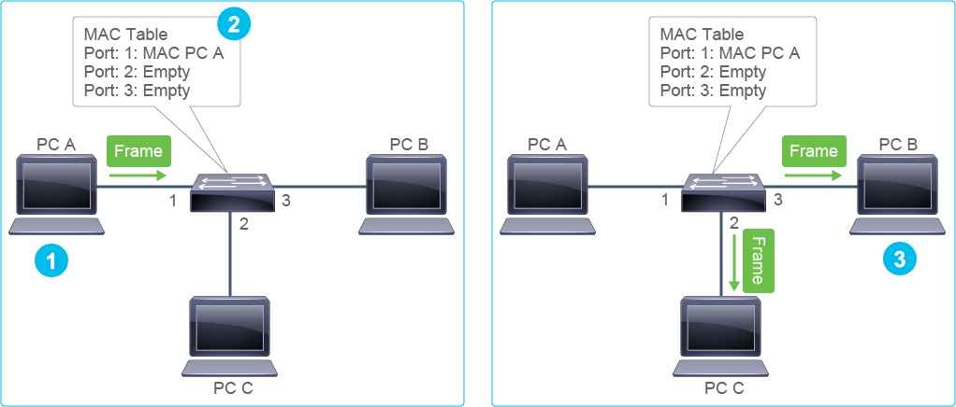

Slide 10
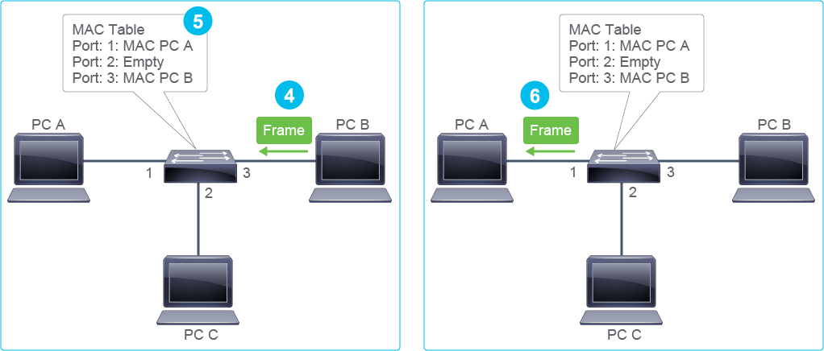

Slide 11
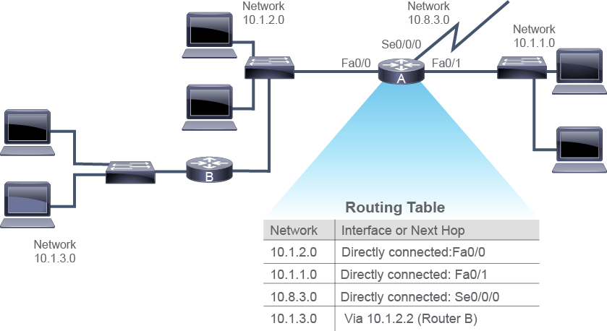
10.1.2.1 – 10.1.1.1
1. Same network? No.
2. Send packet to Gateway!
(Get Router mac, send packet)
3. DST IP Host, DST Mac GW Router
4. Switch forwards to GW
5. Router will forward out of Fa0/1
Mac re-write
SRC MAC Router
DST MAC – Actual destination

Slide 12
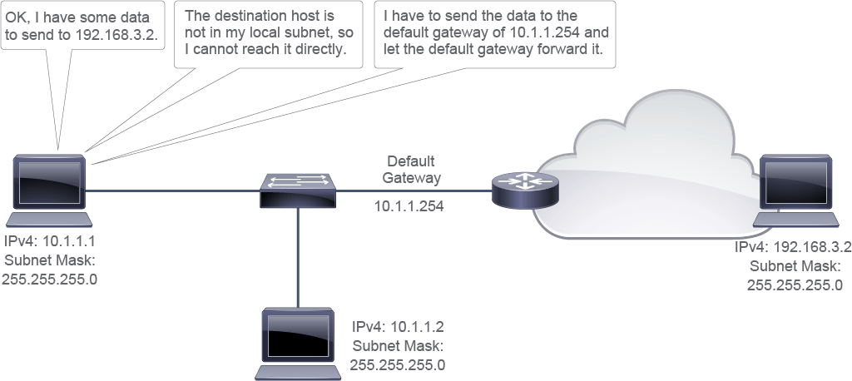

Slide 13
